Slide 1
Shared Facilities & Industry
Jon Shu
CCMR Associate Director

Slide 2
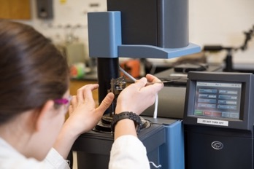

Interacting with Industry
Analytical service or
Instrument use
CCMR Seed Program

Slide 3
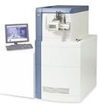
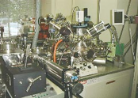
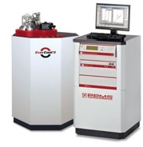

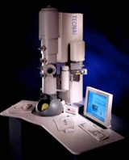

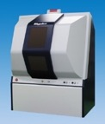
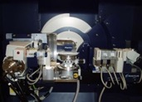
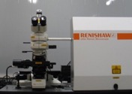
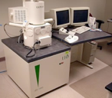
Resources & Expertise
Maldi
XPS
Cryo-TEM
STEM
PPMS
XRD
SEM
Raman
UltraSTEM

Slide 4
Industry User Metrics
Annual metrics:
600 Cornell researchers
~55 External academics
~45 Industry users from 30+ companies. ~10-12% of total revenue
Industry Usage ($) by Technique

Slide 5



























Facility Users from Industry (2011-2017, partial list)

Slide 6
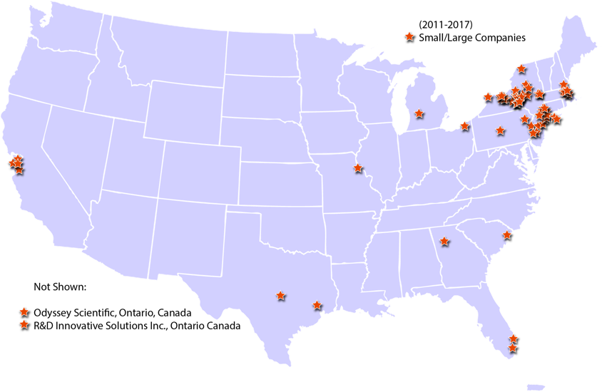

External Usage in Shared Facilities (2011-17)

Slide 7
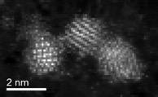
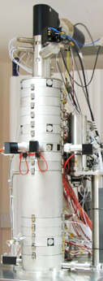
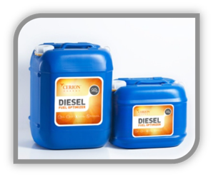
Alignment with Industry Needs
Fe
Produced cerium-based nanoparticles for better diesel combustion
Needed to map composition of Ce-Fe nanoparticles
Ce
Fe
Ce
Fe-rich shell around Ce
Nion UltraSTEM
1999 NSF development MRI

Slide 8
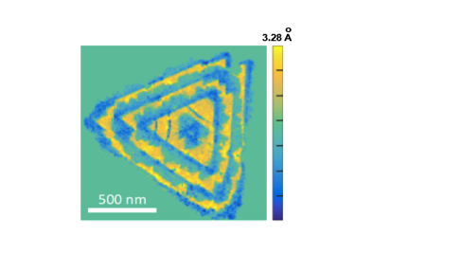

Electron Microscope Pixel Array Detector (EMPAD)/FEI
New STEM detector design captures angular distribution of all transmitted electrons
Lattice constant mapping with picometer precision, of epitaxial WS₂/WSe₂ lateral heterojunctions
100 times the speed vs. conventional detectors
1000 times the dynamic range – 1 to 1,000,000 electrons counted each ms
Effectively triples STEM imaging resolution
TB of data, can extract atom-scale strains, tilts, rotations, polarity, electric/magnetic fields.
Microsc. Microanal. 23 (2017), p. 1712-13

Slide 9
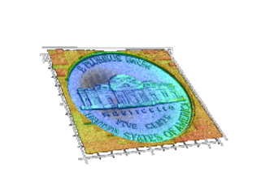
Alignment with Industry Needs – cont’d
Blue-Laser Scanning Confocal Profilometer
5 nm vertical resolution
100 nm X/Y resolution
Non-contact, high angle of detection, works for a wide range of materials.
Semi-transparent film thickness measurements
Keyence
VK-X250
Many referrals from Keyence for: Analysis
Instrument evaluation
New in 2018:
Notes:
Missouri (2), Texas, Michigan, Pennsylvania

Slide 10
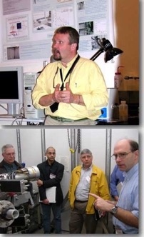
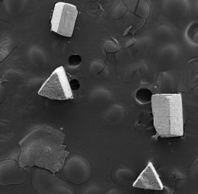
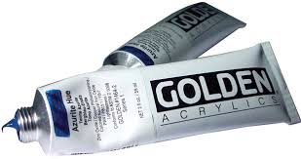
Advertising the Facilities — Facilities 101
Annual 1-day Intro to CCMR Shared Facilities
• Presentations from staff, industry success stories
• Facility tours
• Lunchtime talk by an industrial user of the facilities
• 15-30 minutes of instrument time if you bring samples
The Case of the Cloudy Paint
Mg-Phosphate crystals
Facility Managers discussing capabilities at Facilities 101
~ 20 % of attendees become facility users
500 μm

Slide 11
Typical Questions & Best Practices
Common questions from companies:
Can I send samples for analysis?
Can I see the instrument schedule?
Can I reserve time on the instrument?
Can I come in at any time (day/night)?
Can we be there when you run the samples?
Can we set up an NDA?
Strive for:
Transparency (e.g. all instrument rates posted online, registration)
Clear explanation of data & analyses
Quick turnaround times (1-3 days)

Slide 12
Advertising the Facilities — cont’d
Companies come to us through:
Referrals
Facilities 101
Industrial Partnerships Program
Website, MRFN.org, Google
Exhibitor booth in vendor hall
Fall 2016 & 2017

Slide 13
CCMR Seed Program
New science, materials-related
High risk, high reward
2 years funding maximum
1-2 graduate student endeavor, <$50k for capital
Must have plan for growth, future funding (e.g., SBIR, private, future IRG, etc.)
2004 Seed
Sustainable polymers
Cornell licensed technology
Purchased by Saudi Aramco in 2016
2006 Seed
Functional ionic liquids
Cornell licensed technology

Slide 14

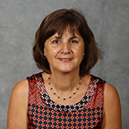
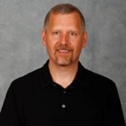
Industrial Partnerships Program
Jumpstart – Solving technical challenges:
Partnered with Cornell faculty
Up to $5k matched to $10k from company
Semester-long project
Invest Gift-Based Program:
Tax-deductible
Any amount, typically $5k - $75k
Low overhead (10%)
No deliverables, trust-based
Fast, no negotiated licensing
INVEST
Michèle van de Walle, Ph. D., M. B. A.
Industrial Partnerships Director
John Sinnott
Industrial Partnerships Manager

Slide 15
Intellectual Property
Sustainable polymers
Seed, Invest, Facility use
Identify, Patent, License
Royalties split:
~1/3 to CTL office
~1/3 to college where IP originated
~1/3 to inventor
Ionic liquids for energy storage
Seed, Jumpstart, Facility use
Nanostructured silicon to improve energy density
of Li-ion batteries
Facility use
Polymer membranes for fuel cells
Jumpstart, Facility use
Nanofibers for filtration and energy storage
Invest, Facility use

Slide 16
Our Challenges
Geographical
Quick service turnaround times
Different and varying needs vs. academics (e.g. ISO standards)
Staffing and instrument concerns if industry revenue significantly increases (or decreases)
When an employee working with us leaves a company we often lose contact w/company
607-255-9833
jbs24@cornell.edu

